Slide 1
Getting started with DHTML
Manipulating HTML elements on run time

Slide 2

Create a new element with Javascript
document.createElement(<tagName>)

Slide 3
Create a new element with Javascript
let element =document.createElement(“div“)
//<div></div>

Slide 4
Create a new element with Javascript
let element =document.createElement(“div“)
//Set the internal html of the newly created element <div></div>
element.innerHTML = “<h1>This is somecontent</h1>”;

Slide 5
Move a tag inside another tag
<div id=“container”>
</div>
let element = document.createElement(‘section’); //<section></ section >
container.appendChild(element)

Slide 6
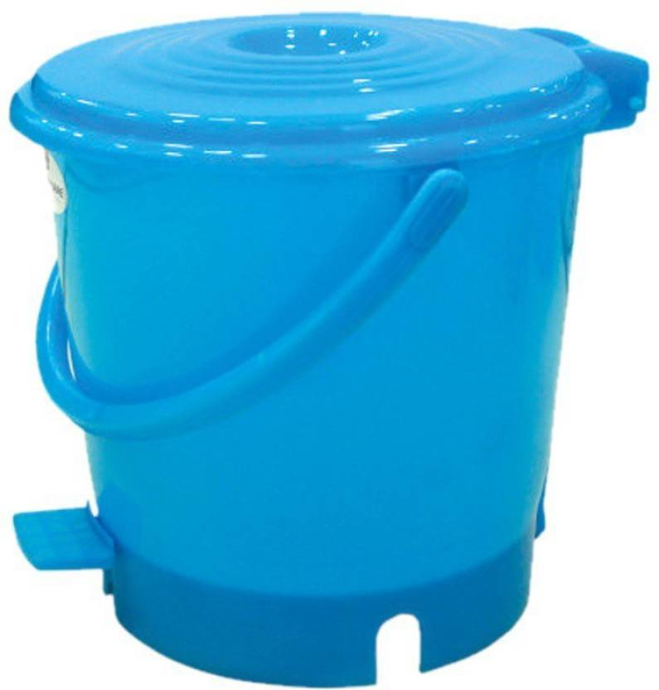
Remove a tag
<div id=“container”>
</div>
container.remove();

